Slide 1
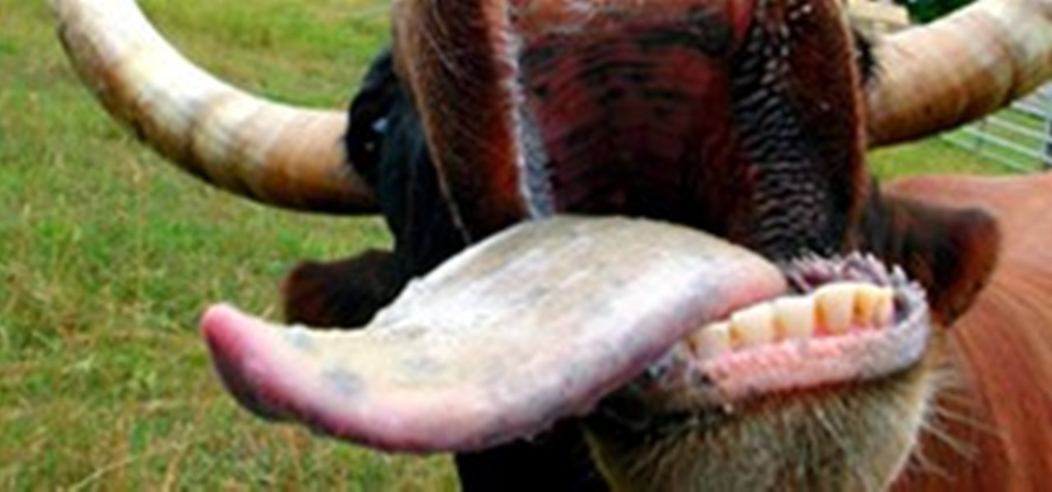
Surgery of tongue and pharynx in ruminant
Asisst. Prof. Dr. Rafid Majeed Naeem

Slide 2
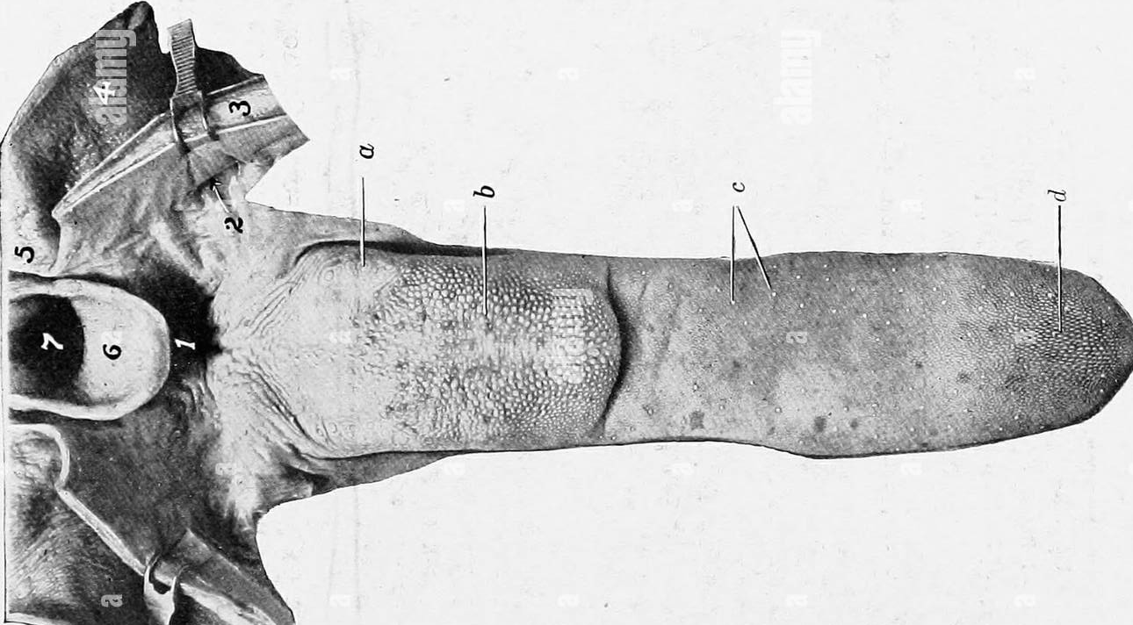
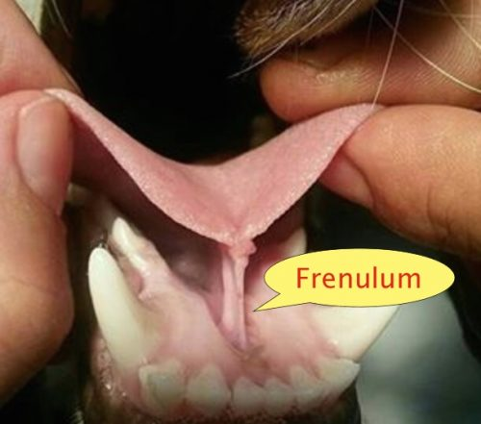
Anatomy of the tongue
The tongue is the most versatile organ in the oral cavity. It is responsible for food prehension, water lapping, sucking, mastication, tasting, swallowing
The tongue consists of
1. a root, which anchors it to the oropharynx;
2. a body, which extends rostral to the root and is attached to the floor of the oral cavity via the frenulum; and
3. the apex, which is rostral and unattached to the frenulum.
Adjacent to each side of the frenulum is a raised area of mucosa running longitudinally called the sublingual fold.

Slide 3
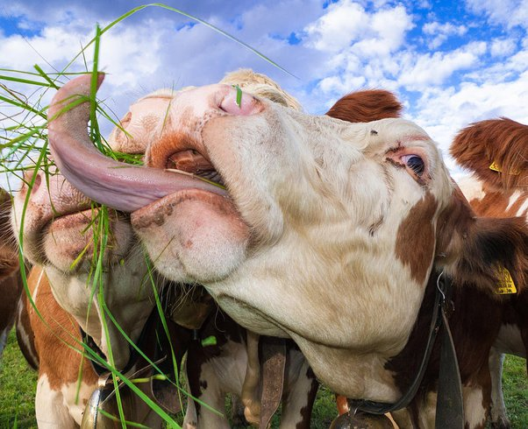
Unlike that of small ruminants, the tongue is most important for prehension in cattle: the tongue grasps forageالعلف and drags it into the mouth where the ventral incisors' pressure against the dental pads cuts it.
The tongue is a rare site for infection, probably because of its rich blood supply, ability to avoid penetrating injury, tough dorsal surface, and continual contact with saliva, which has antibacterial properties.

Slide 4
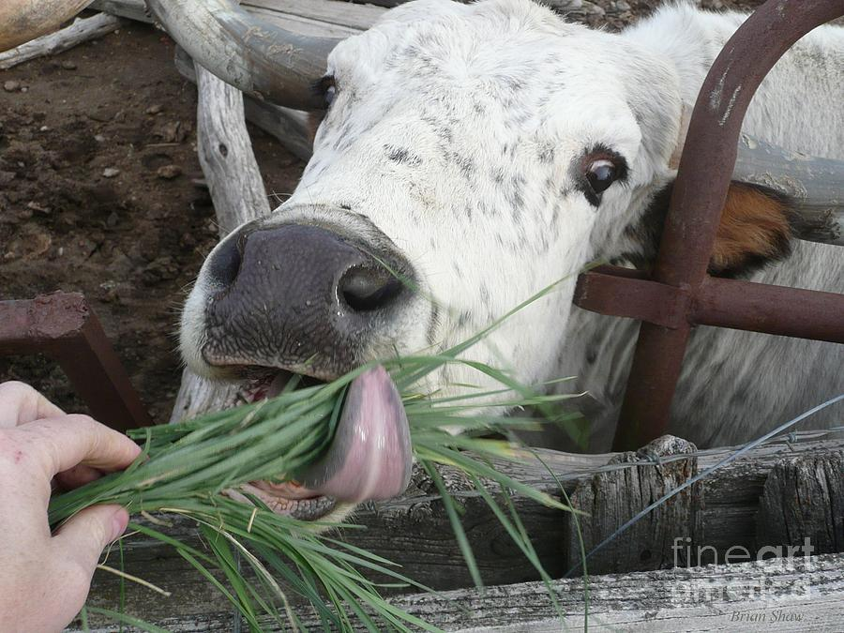
The tongue's importance in prehension explains why tongue amputation after laceration causes greater morbidity in cattle than in horses or small ruminants. Small ruminant lips have replaced the tongue's function as a prehension organ.

Slide 5
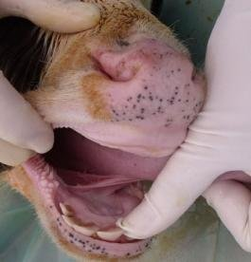
Ankyloglossia is a congenital disorder in which the lingual frenulum is abnormally short and thickened, restricting movement
Affected animal have difficulty suckling, swallowing, resulting in stunted growth, ptyalism, and difficulty eating.

Slide 6
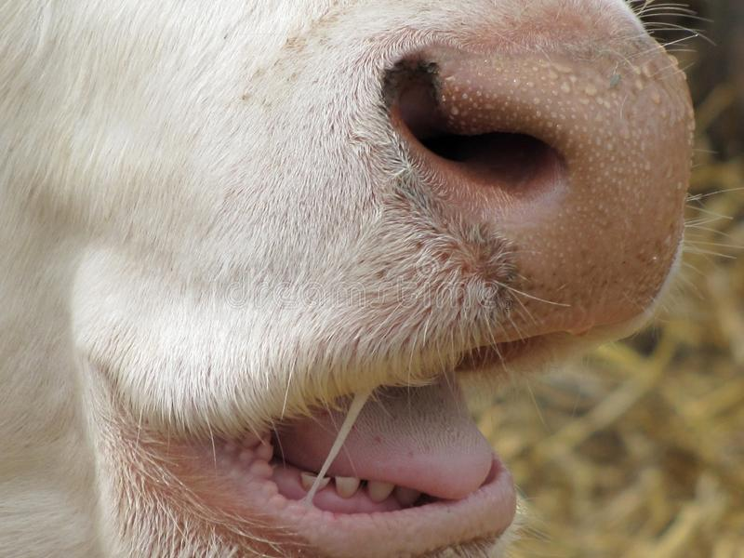
LACERATIONS
lacerations are more common in calves because of their oral prehension and suckling habits on objects in their environment such as barbed wire, needles, and thorns.
The lacerations may involve the lips, buccal membranes, and the tongue.
Animals usually present with excess salivation, which may be mixed with blood, decreased appetite, and various degrees of dysphagia, depending on the severity of the laceration. The animal's tongue often protudes past its lips.

Slide 7
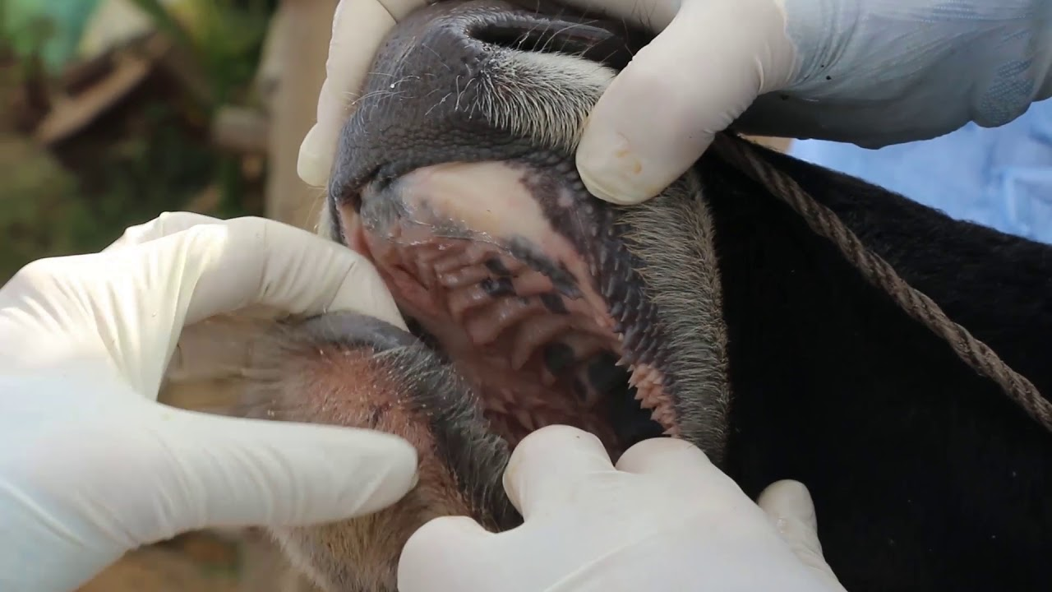
The diagnosis is based on physical examination. First, the head is grasped with one hand on the maxilla at the level of the interdental space. The rostral aspect of the mouth can then be inspected and palpated using the other hand. Most lacerations heal without surgical intervention by using daily mouth lavage and systemic antibiotics and by feeding a soft diet.

Slide 8
Severe tongue lacerations sometimes require a partial glossectomy. Because of the tongue's crucial role in prehension of food, as much of the tongue as possible should be preserved.
In preparation for surgery The animal is anesthetized and placed in lateral recumbency. A tourniquet (made of rolled gauze) is applied proximal to the intended transection site. The tongue is transected so that the dorsal and ventral aspects protrude beyond the center (Figure 10. I -3A).
The ventral and dorsal aspects are sutured together with an interrupted horizontal mattress pattern with a no. I or no. 2 absorbable sutures (Figure 10.1-3B and C).
The animal should receive systemic antibiotics postoperatively and should be fed a soft diet (not pasture) for best results.

Slide 9
Oropharyngeal trauma
cellulitis and dysphagia can occur after improper administration of medication with a balling gun.
Animals are presented because they become anorectic and have an associated decrease in milk production (when relevant).
On examination, they have varying degrees of cervical swelling and associated signs of infections-elevated temperature, leukocytosis, and hyperfibrinogenesis.
The cervical swelling may interfere with respiration, the animal will extend its head and neck while trying to straighten their upper airway (Figure 10.1-4).

Slide 10
A foul smelling odor indicative of necrotic tissue may originate from the mouth.
Endoscopic, or open-mouthed, examination of the nasopharynx and oropharynx will reveal the laceration and/or abscess (Figure 10.1-5). The
cervical area is swollen, and crepitus can sometimes be palpated if the area is not too severely distended.
Ultrasonographic evaluation will reveal pockets of fluids in the subcutaneous tissue of the proximal cervical area.
Radiographic evaluation will reveal air and fluids in the cervical area (Figure 10.1-6).

Slide 11
These animals may aspirate feed and saliva and develop signs of lower airway disease. Therefore the lower airway should be evaluated for signs of mediastinitis (Figure 10.1-7) and aspiration pneumoma.
The treatment principle is to limit the extension of the cellulitis with appropriate parenteral antimicrobials and surgical drainage.
If cellulitis is not controlled, it will proceed alongside the trachea and may result in septic mediastinitis (see Figure 10.1-7). Therefore if there is significant accumulation of fluid and feed material in the cervical area, the accumulated fluid is surgically drained under general anesthesia.

Slide 12
SELF-SUCKLING
Self-suckling is most commonly treated by using a nasal ring with a burr (Figure 10.1-8) or nasal flap and individual housing. If these more conservative treatments are not successful, a partial glossectomy can be considered.

Slide 13
Partial Glossectomy
Two surgical techniques have been created to perform a partial glossectomy to prevent self-suckling in animals. The techniques are performed with sedation and local infiltration of lidocaine or general anesthesia.
Both techniques alter the tongue's contour to prevent the animal from forming aU-shaped tongue for suckling.
For the ventral glossectomy technique, an elliptical incision is made that is approximately 5 cm at its widest part and starts rostral to the frenulum attachment on the tongue and extends rostrally 2.5 cm caudal to the tip of the tongue (Figure 10.1-9A). Each side of the ellipse is incised at an angle toward the midline to facilitate closing the defect, as shown in Figure 10.1-3B.
The lateral glossectomy technique removes half of the tip of the tongue (Figure 10.1-9B). Again, the incision is extended at an angle to facilitate closing the tongue similar to what is shown in Figure 1O.1-3B, except in a different plane.

Slide 14
Oropharyngeal Membrane
Similar to choanal atresia, a persistent membrane can obstruct the oropharynx, thus preventing any milk, saliva or other liquid from reaching the esophagus.
This rare congenital anomaly prevents an animal from ingesting any nutrients. Newborns present with this history and a progressive loss of condition. Treatment has not been reported in large animals, but presumably would consist of membrane resection as described in humans.

